Slide 1
Introduction to Programming (II)
Computer System and Assembly
楊舜仁

Slide 2
References
李哲榮教授上課投影片&講義
J.Glenn Brookshear "Computer Science - AN OVERVIEW", Addison-Wesley
http://www.cs.virginia.edu/~evans/cs216/guides/x86.html
http://www.nasm.us/pub/nasm/releasebuilds/2.09.02/win32/nasm-2.09.02-win32.zip
http://eli.thegreenplace.net/2011/02/04/where-the-top-of-the-stack-is-on-x86/
http://www.ibiblio.org/gferg/ldp/GCC-Inline-Assembly-HOWTO.html
http://ccckmit.wikidot.com/as:inlinec
陳鍾誠 (2010年10月11日)，(網頁標題) 組合語言 — 在 C 語言當中內嵌組合語言，(網站標題) 陳鍾誠的網站，取自http://ccckmit.wikidot.com/as:inlinec ，網頁修改第 0 版。

Slide 3
Outline
From C code to assembly code to machine code
From logic circuit to gate to semi-conductor
How to get assembly code?
From C to assembly code
Advanced syntaxes in assembly
Pointers
Arrays
Function calls

Slide 4
From C code to assembly code to machine code

Slide 5
Computer system
Hard disk
(硬碟)
Mother board (主機板)
CPU (中央處理器)
Registers
(暫存器)
ALU
(計算邏輯單元)
Memory (記憶體)

Slide 6

How is a program executed?
Hard disk
(硬碟)
Mother board (主機板)
CPU (中央處理器)
HelloWorld.c
Registers
(暫存器)
ALU
(計算邏輯單元)
Compiler
Assembly code
Memory (記憶體)
Assembler
Machine code
(Executable)
Machine code
(Executable)

Slide 7
Computer Architecture
Central Processing Unit (CPU) or processor
Arithmetic/Logic unit versus Control unit
Registers
General purpose
Special purpose
Bus

Slide 8
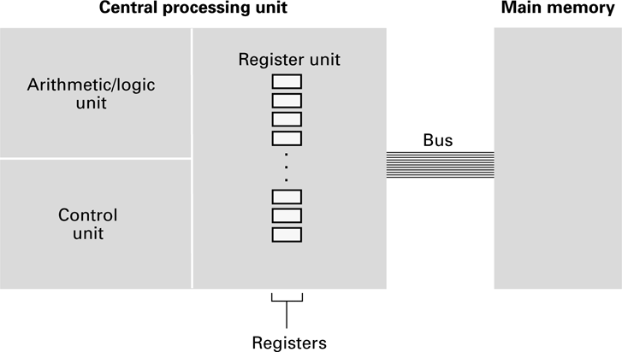
CPU and main memory connected via a bus

Slide 9
Stored Program Concept
Early computers were not known for their flexibility—
the steps that each device executed were built into the control unit as a part of the machine.
A breakthrough: A program can be encoded as bit patterns and stored in main memory.
From there, the CPU can then extract the instructions and execute them.
In turn, the program to be executed can be altered easily.

Slide 10
Terminology
Machine instruction: An instruction (or command) encoded as a bit pattern recognizable by the CPU
Machine language: The set of all instructions recognized by a machine

Slide 11
Machine Instruction Types
Data Transfer
Copy data between CPU and memory/devices
E.g., LOAD, STORE, device I/O,
Control
Direct the execution of the program
E.g., JUMP, BRANCH, JNE (conditional jump),
Arithmetic/Logic
Use existing data values to compute a new value
E.g., ADD, AND, OR, XOR, SHIFT, etc.

Slide 12
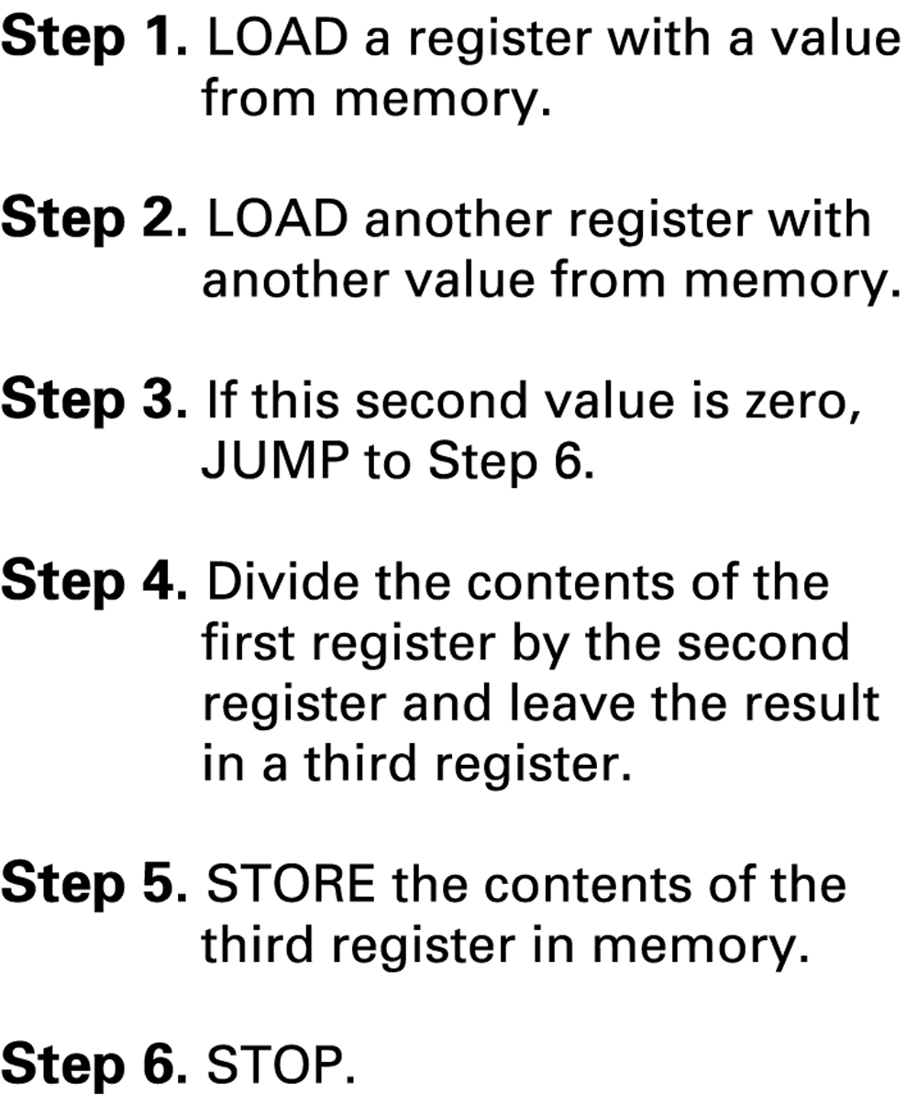
Dividing values stored in memory

Slide 13
Parts of a Machine Instruction
Op-code: Specifies which operation to execute
Operand: Gives more detailed information about the operation
Interpretation of operand varies depending on op-code

Slide 14
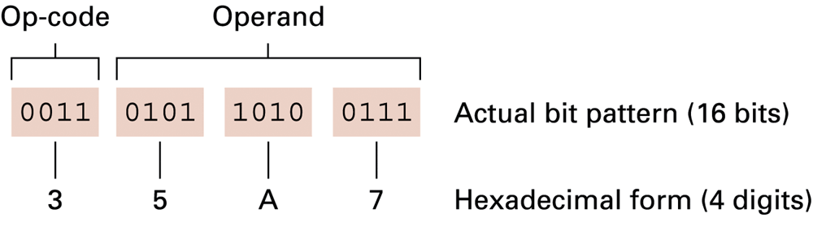
The composition of an instruction

Slide 15
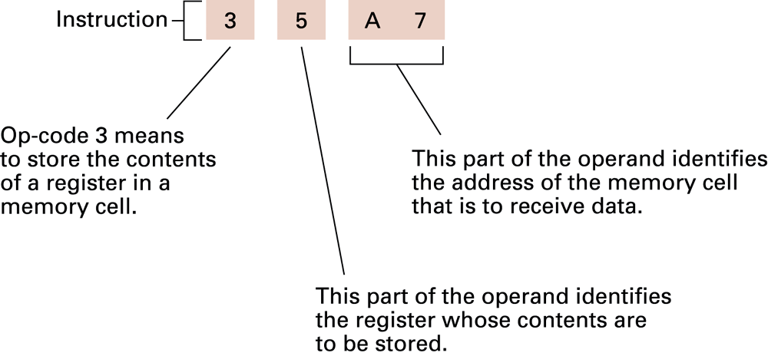
Decoding the instruction 35A7

Slide 16
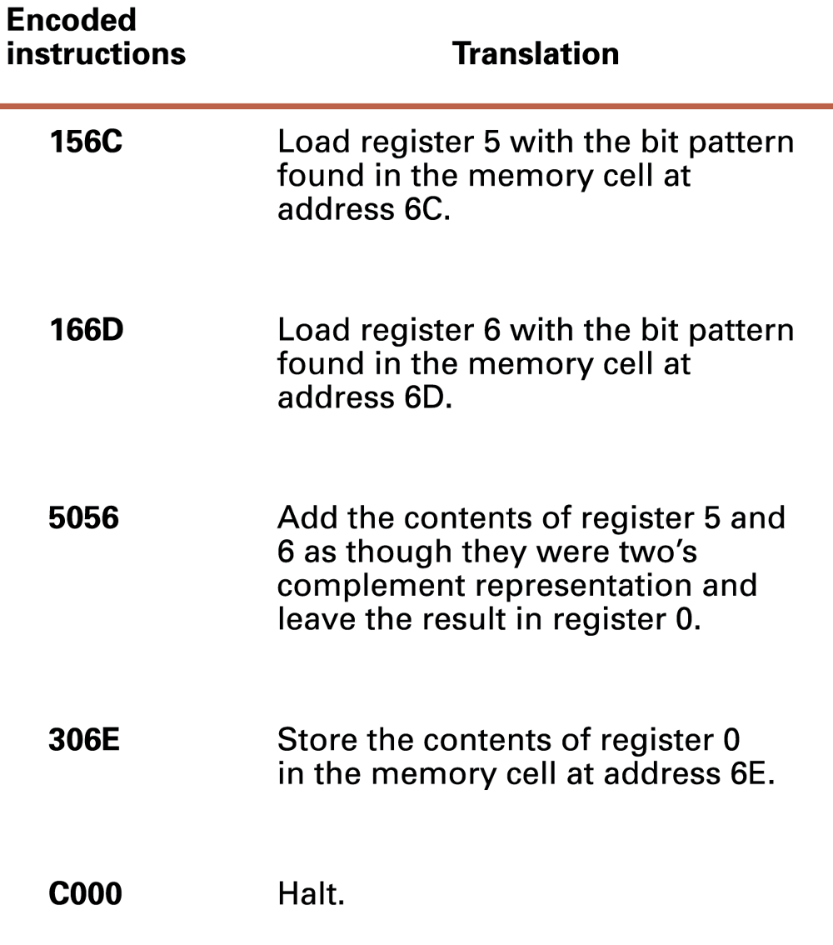
An encoded version of the instructions

Slide 17
Program Execution
Controlled by two special-purpose registers
Program counter: address of next instruction
Instruction register: current instruction
Machine Cycle
Fetch
Decode
Execute

Slide 18
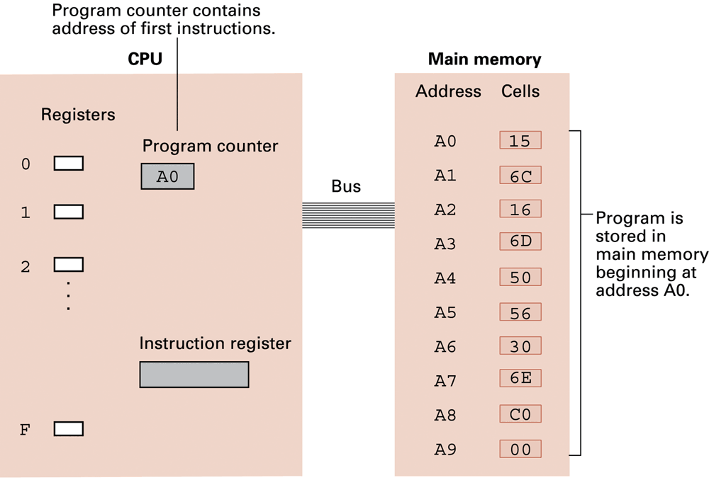
The program stored in main memory ready for execution

Slide 19
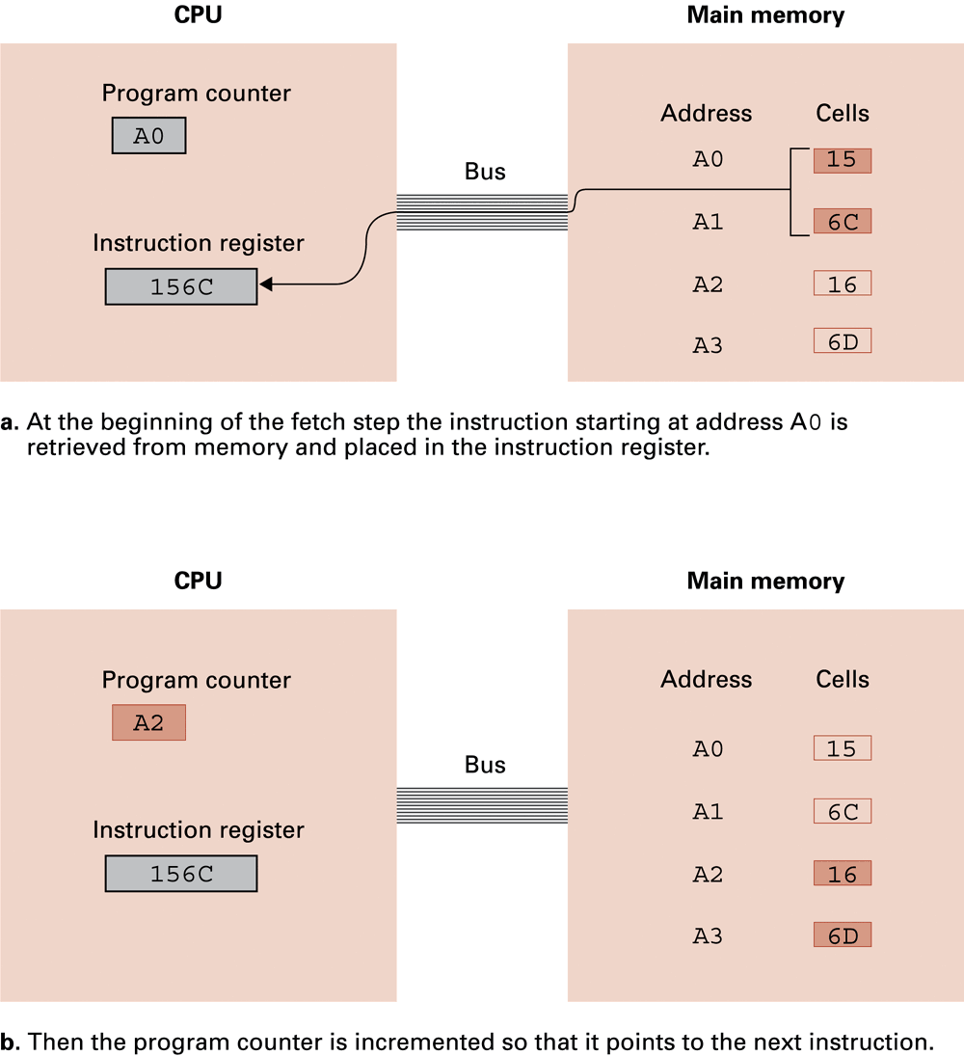
Performing the fetch step of the machine cycle

Slide 20
Performing the fetch step of the machine cycle (cont’d)

Slide 21
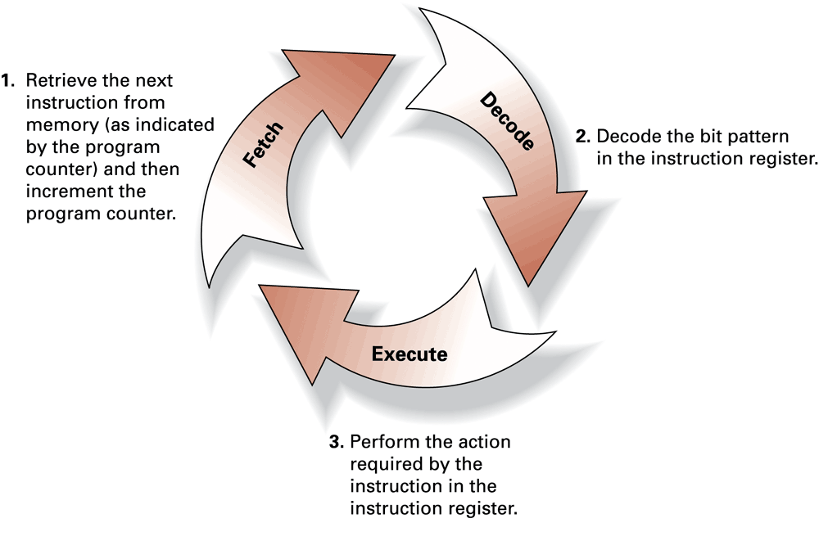
The machine cycle

Slide 22
Assembly language
A mnemonic (幫助記憶的詞句) system for representing machine instructions
Mnemonic names for op-codes
Identifiers: Descriptive names for memory locations, chosen by the programmer

Slide 23
Program Example
Machine language 156C 166D 5056 30CE C000
Assembly language LD R5, Price LD R6, ShippingCharge ADDI R0, R5 R6 ST R0, TotalCost HLT

Slide 24
Assembly Language Characteristics
One-to-one correspondence between machine instructions and assembly instructions
Programmer must think like the machine
Inherently machine-dependent
Converted to machine language by a program called an assembler

Slide 25
From logic circuit to gate to semi-conductor

Slide 26
Instruction execution
Data transfer: load, store, …
Control: jump, jump-equal, …
Change the value of program counter (PC)
Arithmetic/Logic: add, and, shift, …
=> All implemented using logic circuits

Slide 27
Boolean Operations
Inside today’s computers information is encoded as patterns of 0s and 1s.
bit 0: false
bit 1: true
Boolean Operation: An operation that manipulates one or more true/false values
AND
OR
XOR (exclusive or)
NOT

Slide 28
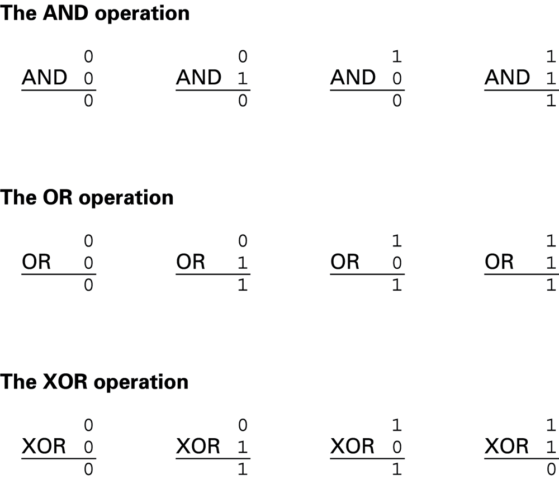
The Boolean operations AND, OR, and XOR (exclusive or)

Slide 29
Gates
Gate: A device that computes a Boolean operation
Often implemented as (small) electronic circuits
Provide the building blocks from which computers are constructed

Slide 30
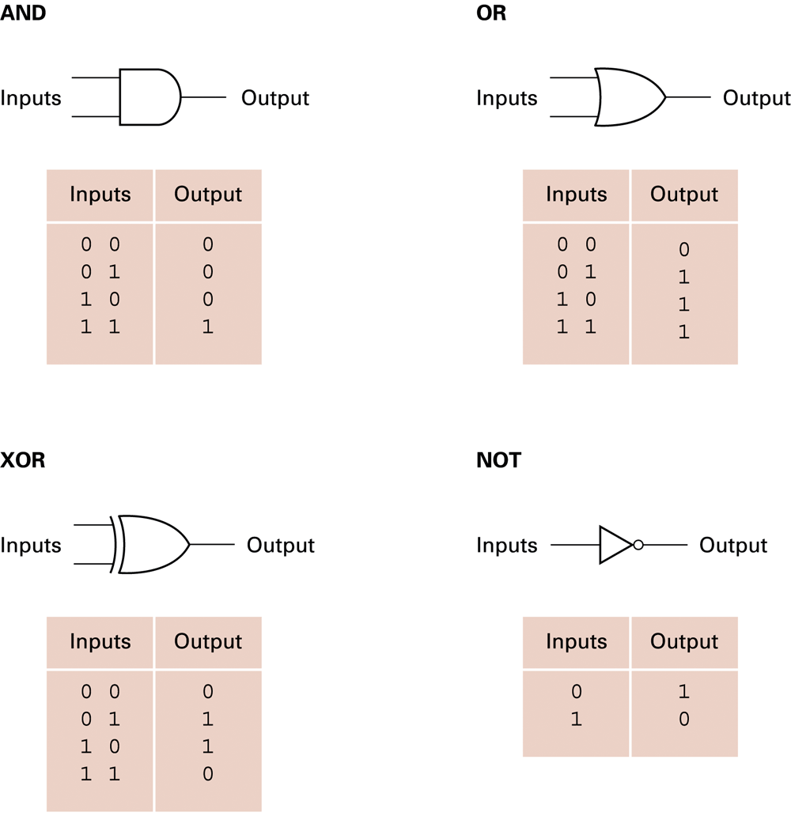
A pictorial representation of AND, OR, XOR, and NOT gates as well as their input and output values

Slide 31
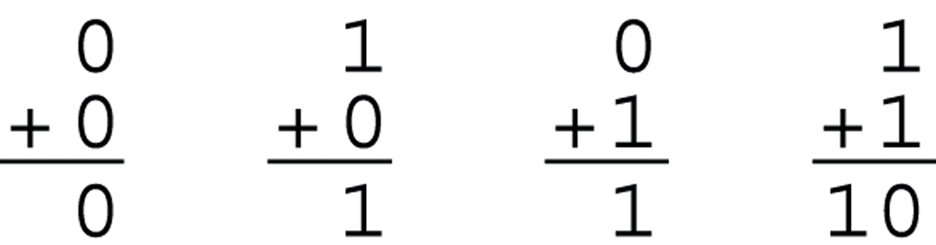
Boolean functions
Almost all binary operations of computers can be carried out by logic gates
Example: One bit adder
Two inputs and two outputs (S: sum, C: carry out)
A: input 1
B: input 2
S: output 1
C: output 2

Slide 32
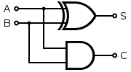
Implementation of one bit adder
The truth table of an one-bit adder
Compare it to the truth table of Boolean function AND, OR, XOR, NOT
S = A .XOR. B
C = A .AND. B
A | B | S | C
0 | 0 | 0 | 0
0 | 1 | 1 | 0
1 | 0 | 1 | 0
1 | 1 | 0 | 1

Slide 33
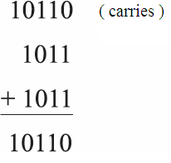
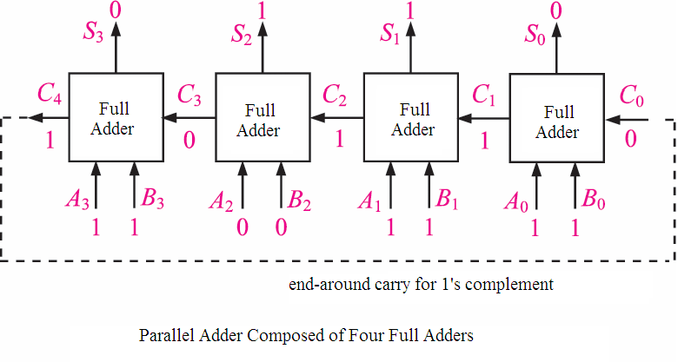
4 bit parallel adder

Slide 34
Circuit gates
A
A
B
B
AND gate
OR gate
A
B
A
A
B
NOT gate
XOR gate
Can we flip the switches without hands?

Slide 35

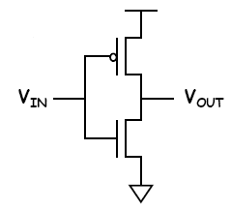
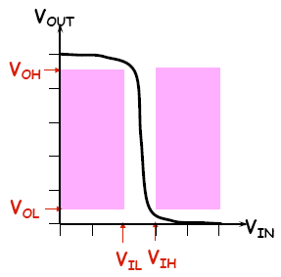
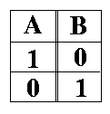
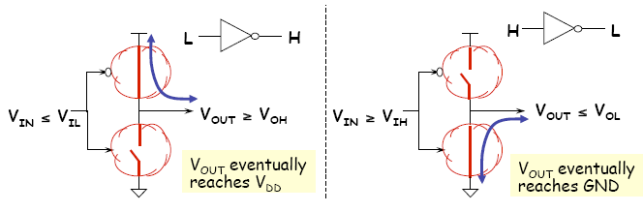
Electronic switch: Transistors for logic gates
CMOS

Slide 36
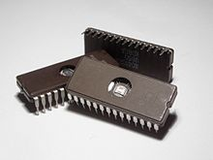
Integrated circuit (IC)
An electronic circuit consisted of transistors and other components in the thin substrate of semiconductor material.
Also known as IC, microchip, or chip.
Invented by Jack Kilby and Robert Noyce
2000 Nobel Prize in Physics
Erasable Programmable Read-Only Memory (EPROM) integrated circuits.

Slide 37
Discrimination
Name | Example | Meaning
Boolean operations | AND, OR, XOR, NOT | Math (logic) concept
Logic gate | AND gate, OR gate, XOR gate | Physical device implementing Boolean operations
Bitwise operators | &, |, ^, ~, >>, << | High level language syntax to process bits

Slide 38
How to get Assembly code?

Slide 39
How to get the assembly code?
In the terminal, use gcc -S ex1.c to get the assembly code of ex1.c
In today’s lecture, we use x86 CPU and intel style’s assembly
gcc -S -masm=intel ex1.c
To generate executable, you can compile the assembly code directly
gcc ex1.s

Slide 40
How to get the assembly code?
To get cleaner and thus more understandable assembly code, we may compile as follows
gcc -S -masm=intel -fno-common -fno-asynchronous-unwind-tables -mno-stack-arg-probe -mpush-args -mno-accumulate-outgoing-args ex1.c

Slide 41
From C to Assembly code

Slide 42
Example 1: assignment 1
C code
Assembly code
int a;
int main(void){
a = 3;
}
mov DWORD PTR _a, 3

Slide 43
MOV instruction
MOV is an instruction in x86’s architecture
In example 1, destination is a memory address, named _a, and source is a constant value (3).
DWORD specifies the data size.
MOV destination, source
Type Specifier | Bytes addressed
BYTE | 1
WORD | 2
DWORD | 4
QWORD | 8

Slide 44
Example 2: assignment 2
C code
Assembly code
What’s differences between ex1 and ex2?
int main(void){
int a;
a = 3;
}
mov DWORD PTR [esp+12], 3

Slide 45
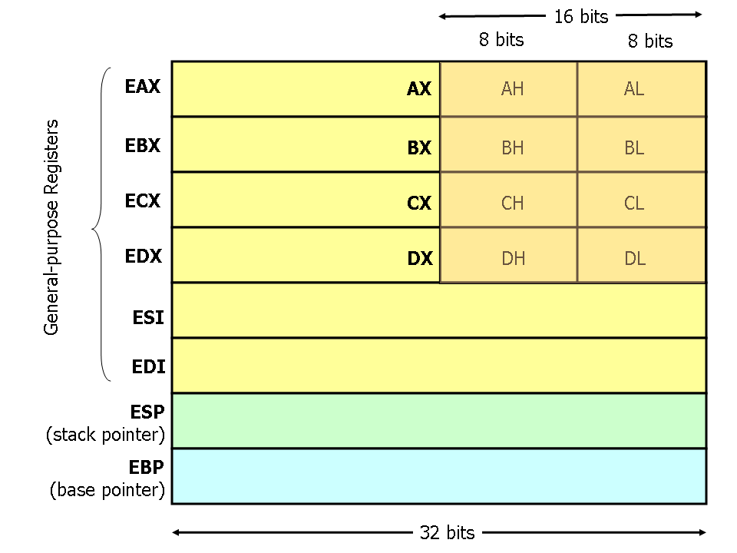
Registers in x86 CPU

Slide 46
Indirect memory access
Register esp holds an address of memory.
[esp+12] is a memory address, whose cell is 12 bytes below the memory cell addressed [esp].
Memory
Address
[esp]
[esp+04]
[esp+08]
[esp+12]
[esp+16]
Register esp

Slide 47
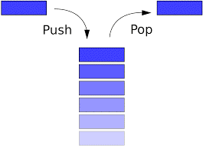
Stack
A stack is a data structure that has two operations: push and pop
push adds an element to the collection;
pop removes the last element that was added.
Elements are only allowed to be added and removed from the “top” of a stack
First come last out

Slide 48
Hardware supported stack in x86 CPU
x86 CPU has a hardware supported stack
Two instructions: push and pop
Register esp (stack pointer): point to the stack top
Register ebp (base pointer): point to the stack base
Used for local variable storage during function execution and other purposes
local variables used by subroutines are placed in memory on the stack.

Slide 49
Stack manipulation for function execution
Before the function is invoked
At the beginning of the function execution
…
local variable n
…
local variable 2
ESP
ESP
local variable 1
…
saved EBP
EBP
EBP
…
…
…
…

Slide 50
Global variable vs. local variable
Variable a in example 1 is a global variable, and in example 2 is a local variable.
 | Global variable | Local variable
Creation | Program starts | Function is called
Life time | Program stops | Function returns
Copies | Only one | The number of function called.
Address | In the data seg | In the stack
Accessible | Everywhere | Within the function

Slide 51
Example 3: assignment 3
C code
Assembly code
eax is another register in x86 CPU
int main(void){
int a, b;
b = a;
}
mov eax, DWORD PTR [esp+12]
mov DWORD PTR [esp+8], eax
Notes:
Continue the game,
Ask each student to have a number in hand.
Put a number in esp, for example, 20
Ask what is the number of in [esp+12], put that to eax
Ask the student in [esp+8] to have the same number

Slide 52
Syntax of MOV
In the syntax of MOV, none of them are destination=mem and source=mem
Why?
<mem> can be a direct address or an indirect address
A single b=a needs 2 instructions.
MOV destination, source
Valid MOV syntax
mov <reg>,<reg> mov <reg>,<mem> mov <mem>,<reg> mov <reg>,<const> mov <mem>,<const>

Slide 53
Discrimination
Name | Example | Meaning
Variable | a, b, c | The high level naming of memory space.
Value | 1, 2, 3 | The value stored in the memory space.
Memory address | [21],[63], [D8] | The address of memory where data are stored.
Register | r1, r5, r10 | Temporary storage of data inside CPU.

Slide 54
Example 4: Add
C code
Assembly code
eax, edx are registers in x86 CPU
int main(void){
int a, b, c;
c = a + b;
}
mov eax, DWORD PTR [esp+8]
mov edx, DWORD PTR [esp+12]
add eax, edx
mov DWORD PTR [esp+4], eax
Notes:
Continue the game,
Ask each student to have a number in hand.
Put a number in esp, for example, 20
Ask what is the number of in [esp+8], put that to eax
Ask what is the number of in [esp+12], put that to edx
Perform add eax, edx
Ask the student in [esp+4] to have the number in eax

Slide 55
ADD instruction
The add instruction adds together its two operands, storing the result in its first operand.
Ex: add BYTE PTR [var], 10
add 10 to the single byte stored at memory address var
Ex: add eax, 10
EAX ← EAX + 10
Valid add syntax
add <reg>,<reg> add <reg>,<mem> add <mem>,<reg> add <reg>,<con> add <mem>,<con>

Slide 56
Example 5: If-else
C code
Assembly code
int main(void){
int a, b;
if (a>3) b++;
}
cmp DWORD PTR [esp+12], 3
jle L3
add DWORD PTR [esp+8], 1
L3:
leave
Notes:
Continue the game,
Ask each student to have a number in hand.
Put a number in esp, for example, 20
Ask what is the number of in [esp+8], put that to eax
Ask what is the number of in [esp+12], put that to edx
Perform add eax, edx
Ask the student in [esp+4] to have the number in eax

Slide 57
Cmp and jle instructions
cmp compares the values of the two specified operands, setting the condition codes in the machine status word.
Machine status word is another register in x86 CPU
jle <label> jumps to the label if the machine status word shows “less than or equal to”

Slide 58
Conditional jump
je <label> (jump when equal)
jne <label> (jump when not equal)
jz <label> (jump when last result was zero)
jg <label> (jump when greater than)
jge <label> (jump when greater than or equal to)
jl <label> (jump when less than)
jle <label> (jump when less than or equal to)

Slide 59
Instruction pointer (IP)
The program (a list of instructions) is stored in memory.
Which instruction to be executed is specified by a special register, called instruction pointer.
In some place, it is called “program counter” (PC).
Normally, IP increases 4 bytes (an instruction). But for jump <label>, it will become the address of the instruction after the label.
<label> represents a memory address.
Notes:
Play the game that give 5 students the following instructions
模擬一下不同的執行
1.call ___main
2. cmp DWORD PTR [esp+12], 3
3. jle L3
4. add DWORD PTR [esp+8], 1
L3:
5. leave

Slide 60
Example 6: while loop
int main(void){
int a, b;
while(a<=3) b++;
}
C code
Assembly code
jmp L2
L3:
add DWORD PTR [esp+12], 1
L2:
cmp DWORD PTR [esp+8], 3
jle L3
leave
Notes:
Continue the game,
Ask each student to have a number in hand.
Put a number in esp, for example, 20
Ask what is the number of in [esp+8], put that to eax
Ask what is the number of in [esp+12], put that to edx
Perform add eax, edx
Ask the student in [esp+4] to have the number in eax

Slide 61
jmp instruction
jmp <label> transfers program control flow to the instruction at the memory location indicated by the operand (<label>).
Instruction jmp is called “unconditional jump”

Slide 62
Different implementation
The implementation is not unique.
int main(void){
int a, b;
while(a<=3) b++;
}
L3:
cmp DWORD PTR [esp+8], 3
jg L2
add DWORD PTR [esp+12], 1
jmp L3
L2:
leave

Slide 63
Advanced syntaxes in assembly

Slide 64
Example 7: pointer
int main(void){
int a;
int *pa;
pa = &a;
}
C code
Assembly code
lea eax, [esp+8]
mov DWORD PTR [esp+12], eax

Slide 65
lea instruction
The lea (Load effective address) instruction places the address specified by its second operand into the register specified by its first operand.
Note, the contents of the memory location are not loaded, only the effective address is computed and placed into the register.
This is useful for obtaining a pointer into a memory region.

Slide 66
Example 8: pointer 2
int main(void){
int a;
int *pa;
pa = &a;
*pa = 3;
}
C code
Assembly code
lea eax, [esp+8]
mov DWORD PTR [esp+12], eax
mov eax, DWORD PTR [esp+12]
mov DWORD PTR [eax], 3

Slide 67
lea eax, [esp+8]
mov DWORD PTR [esp+12], eax
mov eax, DWORD PTR [esp+12]
mov DWORD PTR [eax], 3
Memory
Address
[esp]
Register esp
[esp+04]
3
[esp+08] (a)
[esp+12] (pa)
Register eax

Slide 68
Example 9: array
C code
Assembly code
int main(void){
int a[3];
a[0] = 2;
a[1] = -6;
a[2] = 10000;
}
mov DWORD PTR [esp+4], 2
mov DWORD PTR [esp+8], -6
mov DWORD PTR [esp+12], 10000

Slide 69
Array and pointer
Array | Pointer
A continuous space to store the data of the same data type | A space that stores the address of a specific type of data
a[2]: the third element in that continuous space | *(pa+2): the element that is 2 units away from the element pointed by pa
An array a is a “reference” of a space, which cannot be changed. | A pointer pa can change its content to point to other addresses.

Slide 70
Example 10: function call
C code
Assembly (call foo)
int foo(int a){
return a+1;
}
int main(void){
foo(3);
}
mov DWORD PTR [esp], 3
call _foo

Slide 71
C language calling convention
The calling convention is a protocol about how to call and return from functions.
Two instructions for function call and return
Call: push the current code location onto the hardware supported stack; unconditional jump to the code location indicated by the label operand.
Ret: pop the current code location from the hardware supported stack; unconditional jump to the popped code location.

Slide 72
Recall: Hardware supported stack
x86 CPU has a hardware supported stack
Two instructions: push and pop
Register esp (stack pointer): point to the stack top
Register ebp (base pointer): point to the stack base
Used for function calls
Registers are saved on the stack.
Subroutine parameters are passed on the stack, and
local variables used by subroutines are placed in memory on the stack.

Slide 73
The flow of a function call
Caller calls the function
Callee starts the function
Callee performs the function
Callee returns
Caller restores
Caller: the one who makes the function call
Callee: the called function

Slide 74
Caller rules to call function
Before calling a function, push the contents of certain registers to the stack.
The caller-saved registers are EAX, ECX, EDX.
To pass parameters to the subroutine, push them onto the stack before the call.
To call the function, use the call instruction.
Instruction call pushes the return address on top of the parameters on the stack, and jumps to the function code.

Slide 75
Callee rules to start a function
Push the value of EBP onto the stack, and copy the value of ESP into EBP
Allocate local variables by making space on the stack.
Push the values of the callee-saved registers that will be used by the function.
The callee-saved registers are EBX, EDI, and ESI

Slide 76
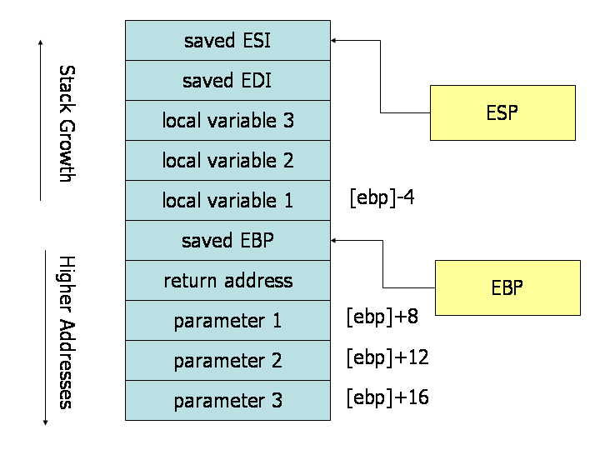
Function call memory layout (after the above two sets of rules)

Slide 77
Callee rules to return
Leave the return value in EAX.
Restore the old values of any callee-saved registers (EDI and ESI) that were modified.
Deallocate local variables.
Before returning, restore the caller's base pointer value by popping EBP off the stack.
Return to the caller by executing a ret instruction.

Slide 78
Caller rules to restore
Find the return value of function in the register EAX.
Remove the parameters from stack.
This restores the stack to its state before the call was performed.
Pop off the contents of caller-saved registers (EAX, ECX, EDX) from the stack.
The caller can assume that no other registers were modified by the callee.

Slide 79
An example function definition that follows the callee rules
_myFunc PROC
; Subroutine Prologue (序言)
push ebp ; Save the old base pointer value.
mov ebp, esp ; Set the new base pointer value.
sub esp, 4 ; Make room for one 4-byte local variable.
push edi ; Save the values of registers that the function
push esi ; will modify. This function uses EDI and ESI.
; (no need to save EBX)
(cont'd)

Slide 80
; Subroutine Body
mov eax, [ebp+8] ; Move value of parameter 1 into EAX
mov esi, [ebp+12] ; Move value of parameter 2 into ESI
mov edi, [ebp+16] ; Move value of parameter 3 into EDI
mov [ebp-4], edi ; Move EDI into the local variable
add [ebp-4], esi ; Add ESI into the local variable
add eax, [ebp-4] ; Add the contents of the local variable
; into EAX (final result=sum of the three
parameters)
(cont'd)

Slide 81
; Subroutine Epilogue (收場)
pop esi ; Recover register values
pop edi
mov esp, ebp ; Deallocate local variables
pop ebp ; Restore the caller's base pointer value
ret
_myFunc ENDP
(end)

